Slide 1
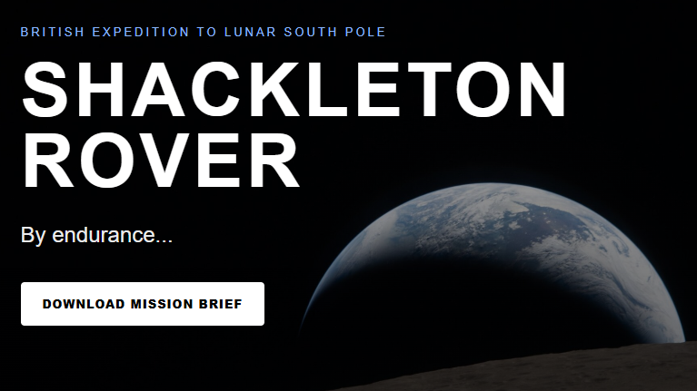

Slide 2

A new adventure The exploration of the next pole www.shackletonrover.co.uk Patrick Harkness Professor of Exploration Technology University of Glasgow

Slide 3

Ice unlocks deep space The global space economy is worth $626 billion, and projected to grow to over $1 trillion by 2034. The single greatest barrier is the cost of launching propellant from Earth. Water-ice exists at the lunar south pole. This can be broken into hydrogen and oxygen, the best possible propellants. However, no spacecraft has yet made contact with this resource. It may be buried in the shallow subsurface. We do not know. We must touch it. This is the UK's opportunity to lead.

Slide 4

A window of opportunity We have a short window of time in which a small rover could still make first contact with the ice. This small rover is possible with our resources. The discovery will enable us to take advantage of the emerging space economy position us for a consultative role in lunar regulation. Antarctica is the world’s greatest example of international partnership, and the UK helped build the framework. We can do it again. A new global commons on the Moon.

Slide 5
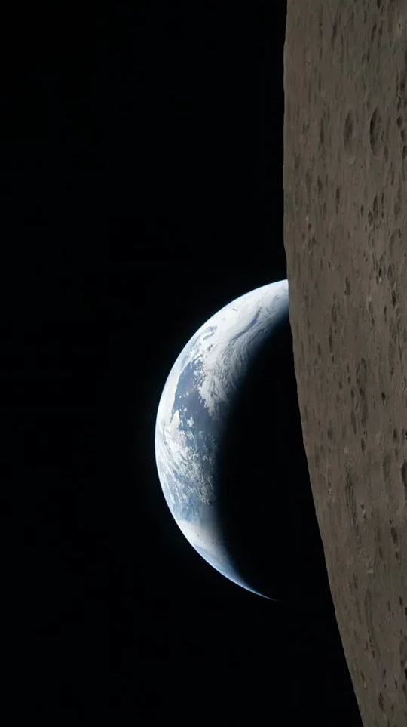
Achievability and competition The UK already builds lunar descent engines and Mars landers. Intuitive Machines owns an antenna in Cornwall. We have the team we need to run full missions. We are well-placed to succeed because we have low-gravity drill technologies that could allow us to reach the subsurface. Our competitors are not attempting to explore at depth. With the credibility of landing, we can leverage our convening power, on the world stage, convert these achievements into meaningful principles for the exploration of outer space.

Slide 6
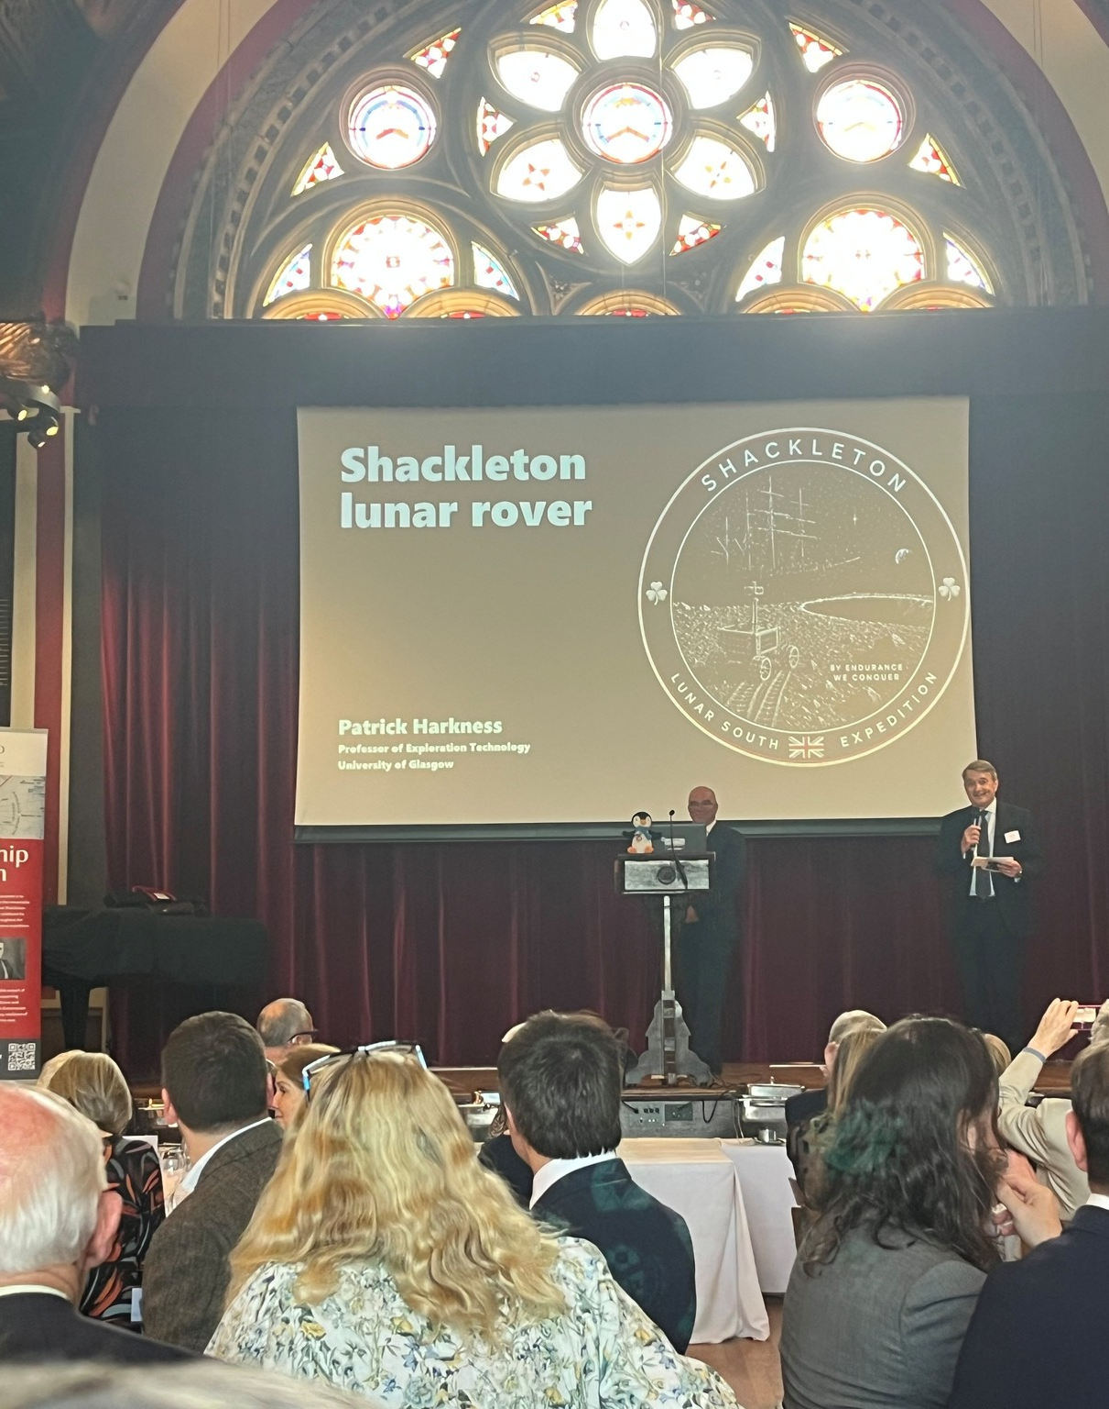
Why now? The UK needs to move quickly, if we are to secure the first-mover advantages that are achievable with a small rover. There is no greater prize. We estimate it will require £25m to attempt it. The UK Government has funding worth around £5m. With £20m in private finance we can seize this opportunity.

Slide 7
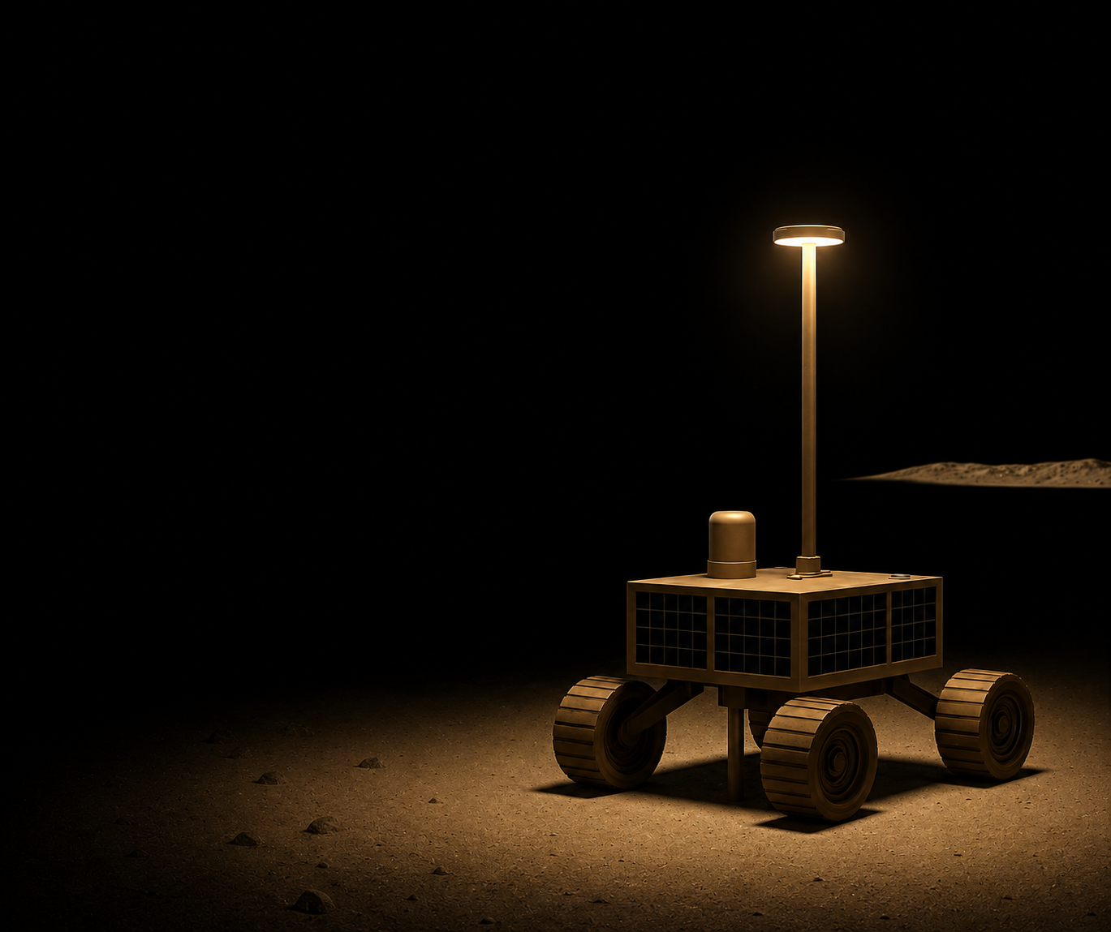
What will make our first contact? The spacecraft: We propose a 20kg rover with skid-steering, delivered on a commercial contract. The mission: 14 days, using solar power, with sorties into the shadowed regions. The payload: A penetrator to probe the subsurface in pursuit of ice. The goal: first contact with water on the moon.

Slide 8


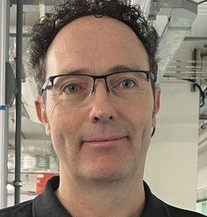


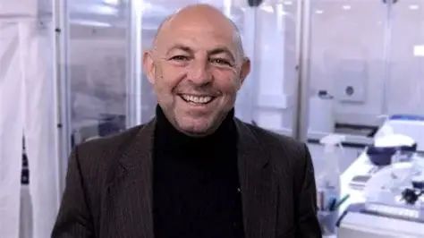
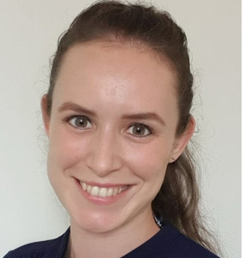
Who is on board?
Coordinator: Patrick Harkness, University of Glasgow, works on low-force terrain penetration tools
Delivery: Ben Bussey, Intuitive Machines, is Chief Scientist at a CLPS contractor
Architecture: Simeon Barber, Open University, worked on Beagle2, lunar instruments, and drill systems
Instrumentation: Neil Bowles, University of Oxford, leads lunar instrument systems
Operations: Steven Banham, Imperial College has experience of operating the Curiosity rover on Mars
Costing: Javier Martin-Torres, Northumbria University, leads instruments on Mars
Terrain Interactions: Hannah Sargeant, University of Leicester, leads on in situ resources

Slide 9
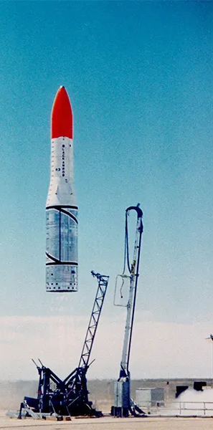
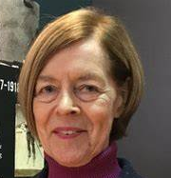
The story we will tell The Honourable Alexandra Shackleton is the Patron of our mission. We will boost national morale with an inspirational story. We will create a renewed example of perseverance, discovery, and ambition at the next polar frontier. We will position the UK for the future space economy while setting the Antarctic example of partnership on the Moon. Symbolising these values, we will carry a piece of the RRS Discovery to the Moon; just as the Ingenuity helicopter carried part of the Wright Flyer to Mars.

Slide 10
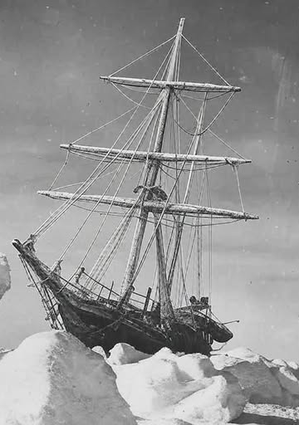
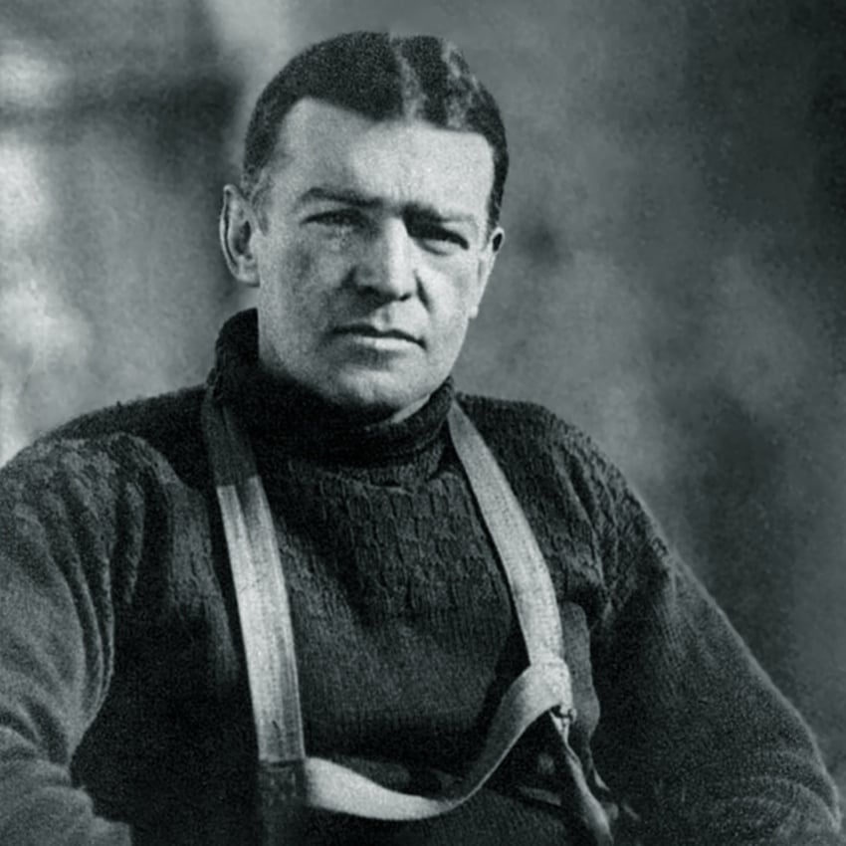
Our inspiration Sir Ernest Shackleton and the Endurance Sir Ernest Shackleton set out to cross Antarctica. After his ship was crushed by the ice, he led 28 men on foot for hundreds of miles, rowed to a barren island, sailed almost a thousand miles more, and crossed a mountain range. He saved every man. His story has become a byword for resilience, optimism, and the importance of a pioneering spirit. We will do something worthy of his example.
The Steam Yacht Endurance, trapped in polar ice, 1915.

